Slide 1



Team: Migration Overflow
Shubham Tulsyan
Ashish Chauhan
Divyanshu Pathak
Aman Singh
Nitish Pareek
Product Coach: Subhodeep Sarkar | Tech Coach: Subham Chowdhury

Slide 2
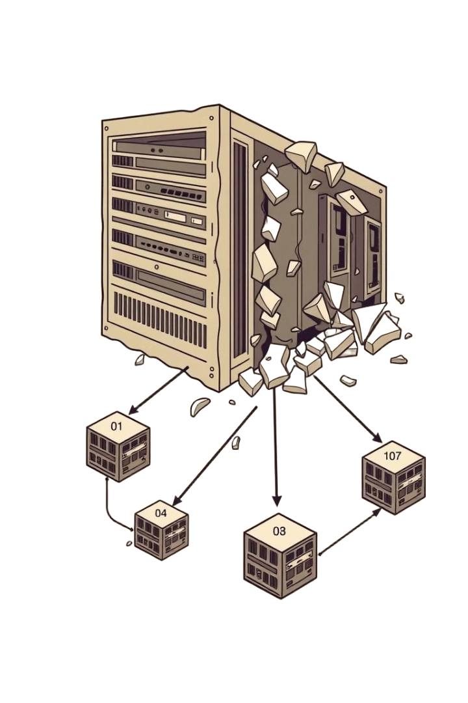
Dive into the Issue
Manually analyzing and migrating large monolithic codebases to microservices is slow, error-prone, and requires deep technical expertise. There is a need for an intelligent, automated solution that can analyze code, suggest service boundaries, and generate a clean microservice structure with minimal manual effort.
Notes:
1

Slide 3
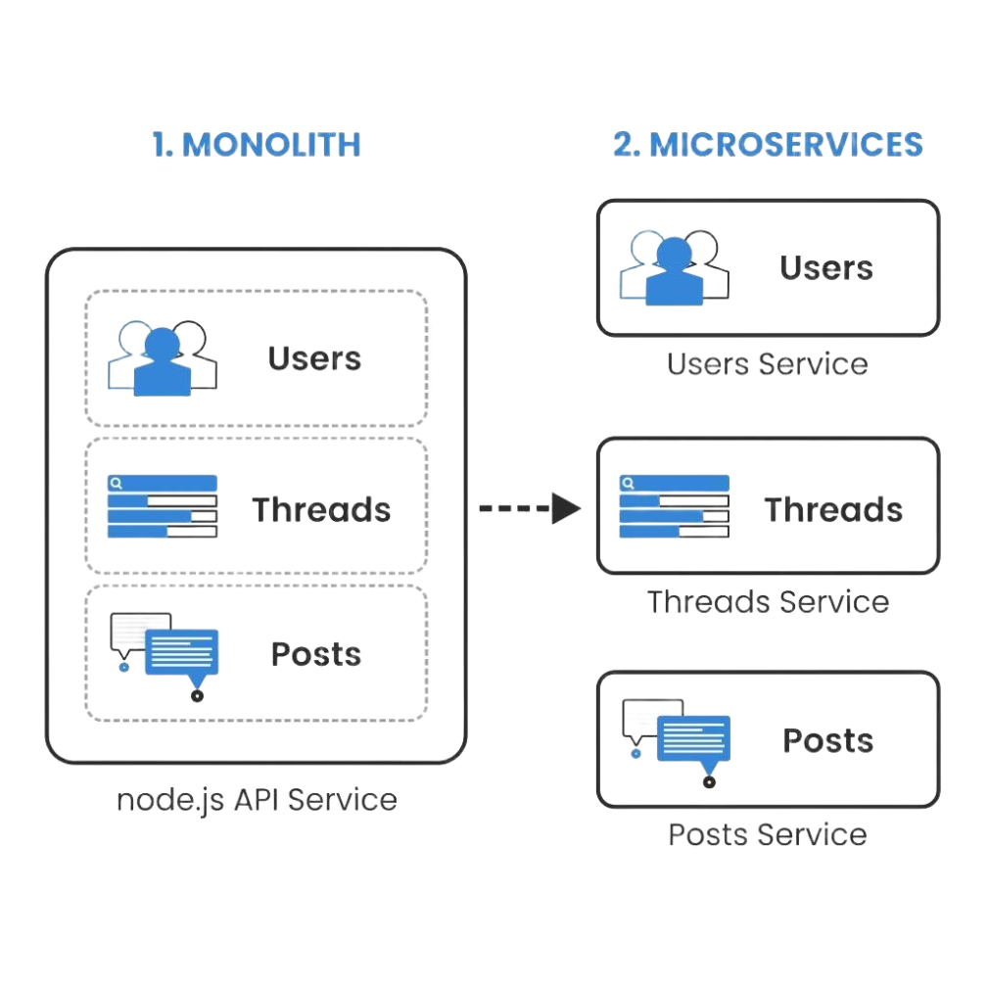
Monolithic to Microservices Migration Plan Generator
This project focuses on analyzing an existing monolithic codebase. It is systematically transforming it into a microservices architecture. The process leverages LLMs for intelligent code understanding, service decomposition, and documentation.
Notes:
2

Slide 4





Project Objectives
Understand and evaluate the structure of the monolithic application
Identify logical service boundaries
Propose a microservices-based structure
Automate documentation and folder generation using LLMs
Deliver a structured .MD File and folder layout for developers
Notes:
6

Slide 5
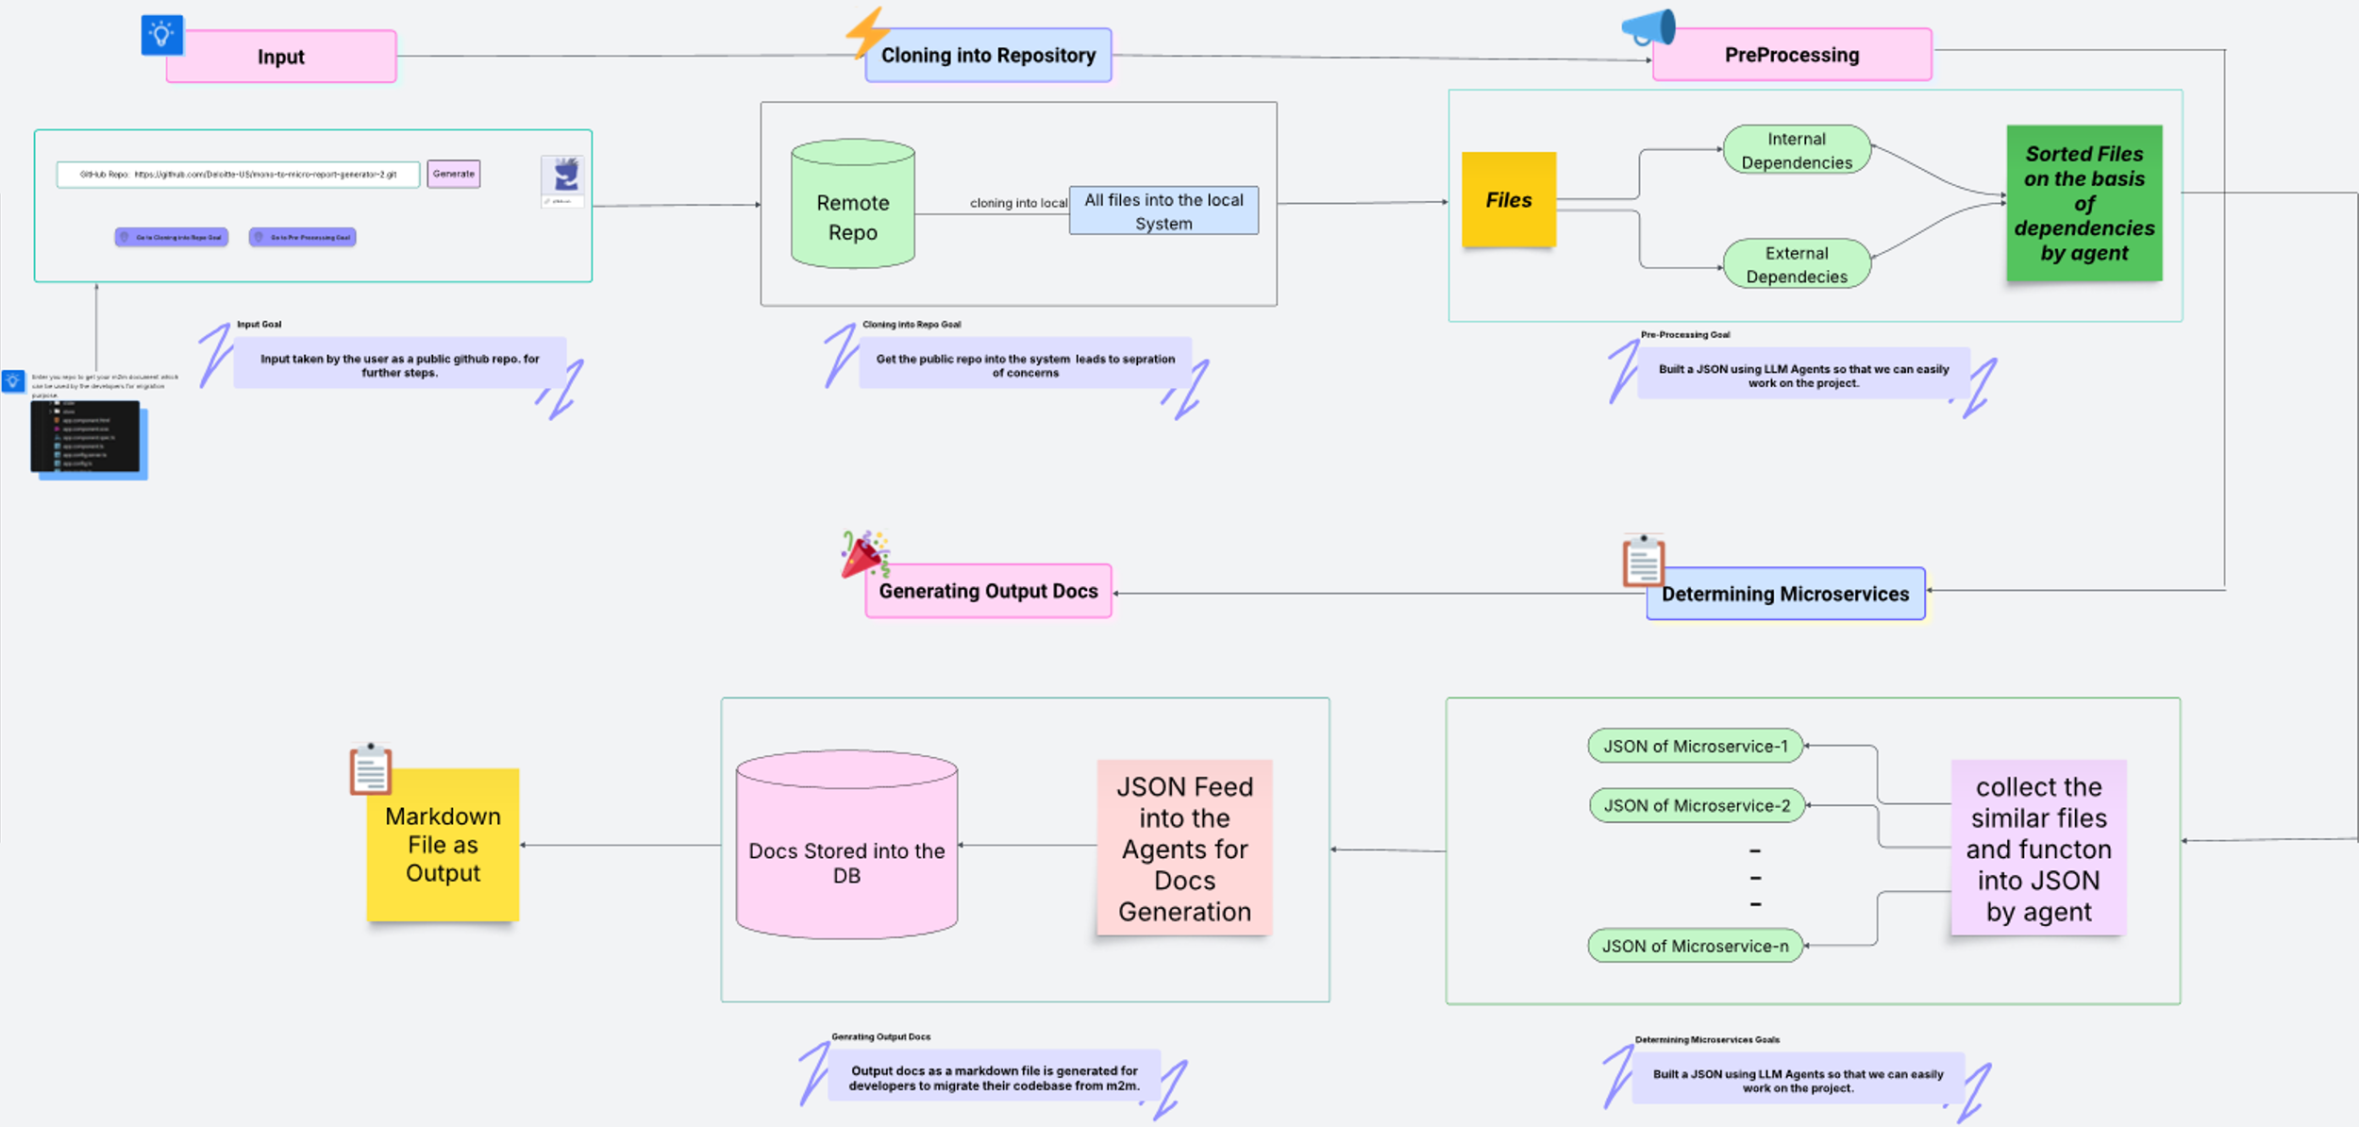
High Level Diagram (HLL)

Slide 6


Repository Cloning & File Analysis
Clone the monolithic repo to local workspace
Scan files to extract structure and content
Identify classes, methods, and dependencies
Prepare data for further analysis steps
Notes:
7

Slide 7
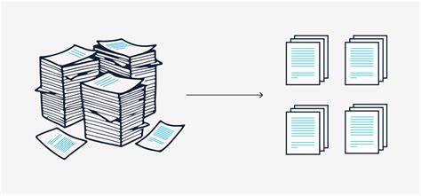
File Sorting
Build internal dependency graph between files
Detect and handle circular dependencies if present
Sort files based on dependency resolution order
Ensure correct execution flow for microservice extraction
Notes:
8

Slide 8

Identifying possible microservices
Analyze internal file dependencies
Group files with strong cohesion
Identify functional boundaries
Propose initial microservice clusters

Slide 9
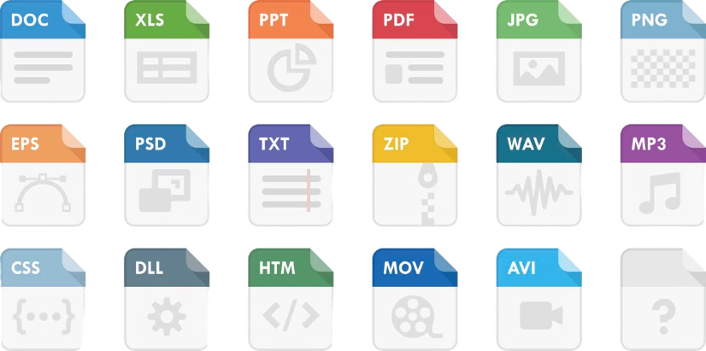
Generating Code Plan
Generating Code Plan
Map each file to a target microservice
Extract function details and responsibilities
Detect cross-microservice function calls
Structure output into JSON for each microservice
Map each file to a target microservice
Extract function details and responsibilities
Detect cross-microservice function calls
Structure output into JSON for each microservice
Notes:
9

Slide 10
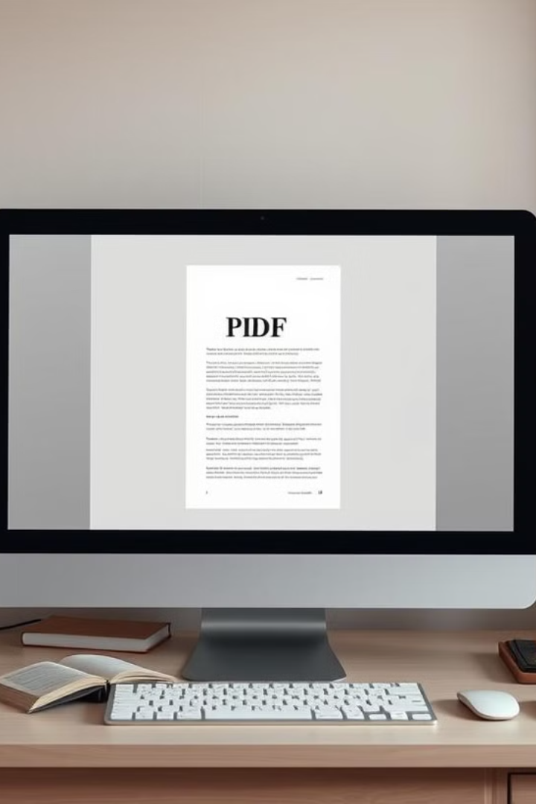
Consolidated Markdown File
Consolidated Markdown File
Combine all microservice plans into one document
Include file paths, functions, and dependencies
Highlight cross-service interactions clearly
Present as a developer-friendly migration guide
Combine all microservice plans into one document
Include file paths, functions, and dependencies
Highlight cross-service interactions clearly
Present as a developer-friendly migration guide
.md
Notes:
11

Slide 11
THANK YOU
Notes:
13

